Slide 1
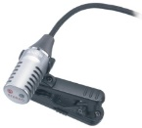
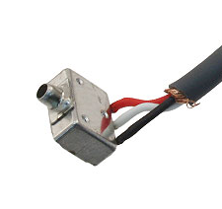
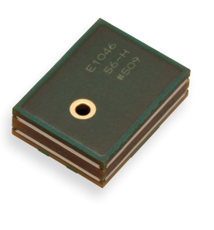
“Sony Mic”
Sony ECM-CS10
Lapel Electret
$38
“PCB Mic”
Knowles SPH1642
SMT Silicon MEMS
$2
“Knowles Mic”
Knowles EK-23024
Hearing Instrument
$17

Slide 2
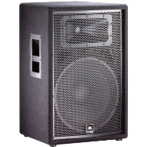

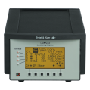
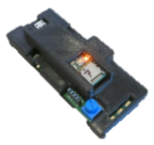
Speaker
“Truth” Mic
DAQ
Mic
Electronics (w/SD)
Tympan

Slide 3
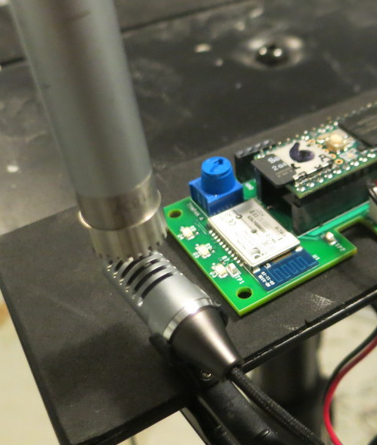
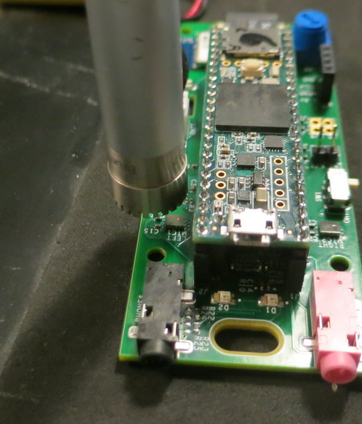
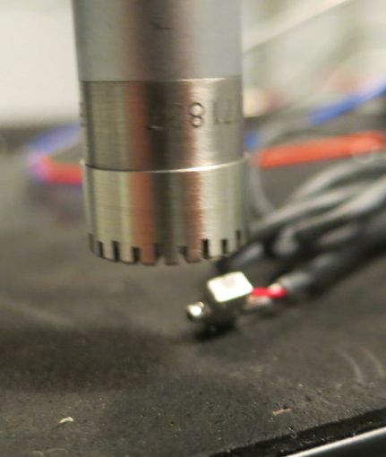
Calibrating Different Microphones with Tympan
“Truth”
Mic
“Truth”
Mic
“Truth”
Mic
PCB
Mic
Sony
Mic
Knowles
Mic

